Slide 1
GROUP 8
FINAL PROJECT
MIS6382.501

Slide 2




Group Members
SONJE, RUCHA SURESH (RXS230024)
HUAI HUAN,LIU (HXL220061)
SINGH, CHAVI (CXS220049)
SONJE, VIPUL SURESH (VXS230000)

Slide 3
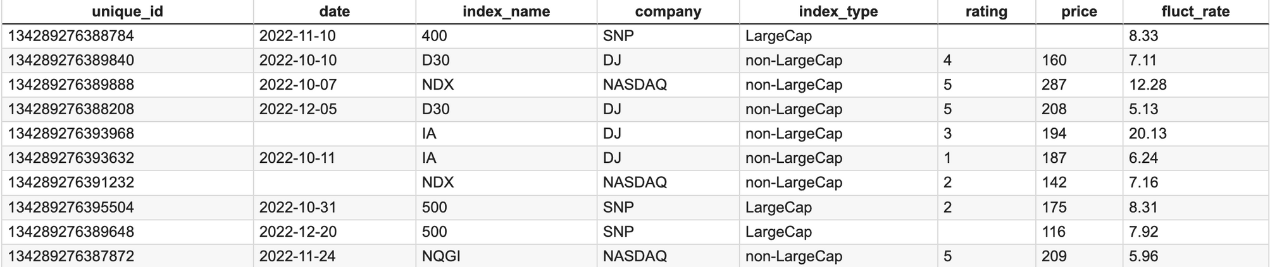
INTRODUCTION OF DATA
Comparing Index provided by different companies through rating, price, and fluctuation rate.
Total number of records: 5,000
Data Type:
Integer
Object
Object
Object
Object
Float
Float
Float
Data Cleaning:
Mode
Mean
Mean
Median

Slide 4
In the comparison between Large Company and Non-Large Company indices,
which type of index has a higher number?

Slide 5
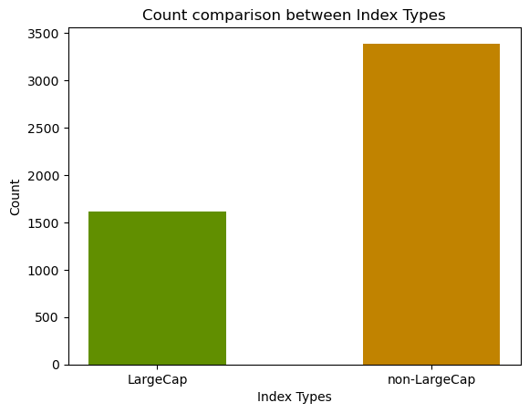
DATA VISUALIZATION 1
Bar Chart
The comparison focuses on two types of indices: Large Company and Non-Large Company.
A distinct trend is evident, revealing that the number of Non-Large Company indices exceeds that of Large Company indices.

Slide 6
Which company stands out as an index provider?

Slide 7
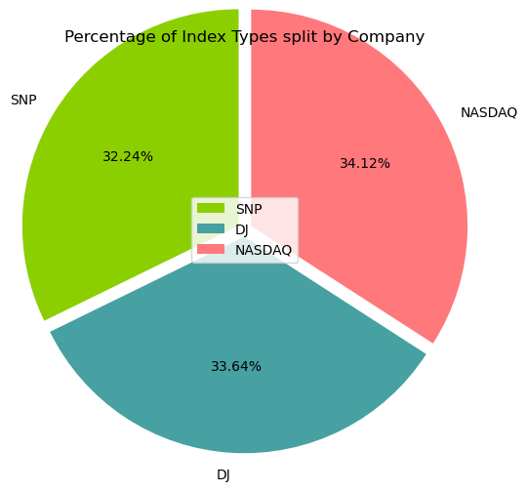
DATA VISUALIZATION 2
Pie Chart
The distribution of companies contributing to the highest number of indices.
"NASDAQ" stands out as the dominant player, with the largest share at 34.12% among index providers.

Slide 8
Among the three companies compared in terms of
price distribution for indices,
which company exhibits the widest range of prices?

Slide 9
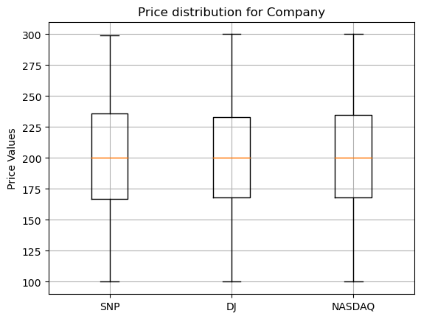
DATA VISUALIZATION 3
Box Plot
Price distribution comparison among three companies.
The range of indices' prices from these companies doesn't show significant differences.
Company DJ has the shortest length in terms of price distribution.

Slide 10
In general, what was the trend in fluctuation rate throughout 2022?

Slide 11
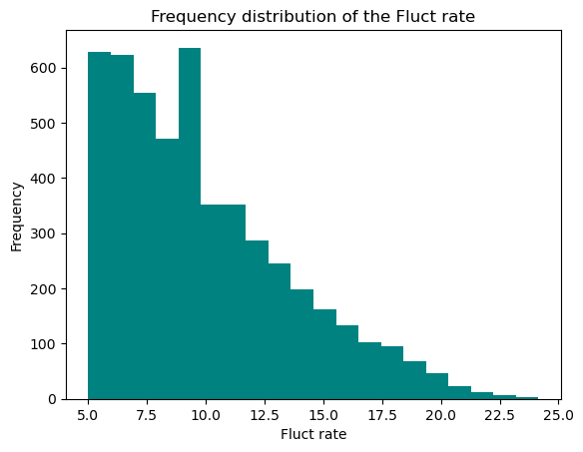
DATA VISUALIZATION 4
Histogram
The frequency distribution shows a negative correlation with the fluctuation rate.
The frequency peaked at over 600 when the fluctuation rate was between 8 and 9.
The frequency histogram is right-skewed.

Slide 12
What is the difference in
the trend of fluctuation rate between
two non-large companies?

Slide 13
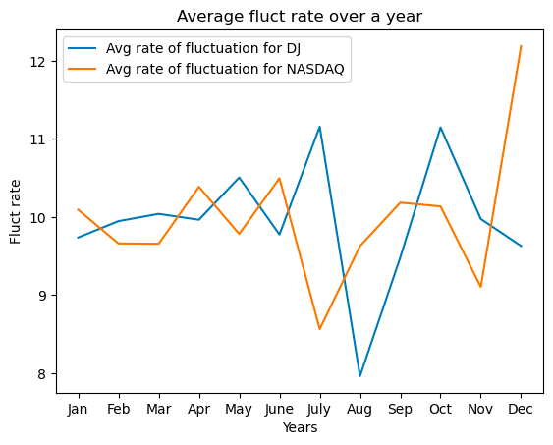
DATA VISUALIZATION 5
Line Graph
The comparison between the trend of fluctuation rate of two companies, DJ and NASDAQ
The two companies exhibit opposite trends.
Company DJ: Hit the lowest point in August and peaked in July and October.
Company NASDAQ: Experienced its lowest point in July and reached its peak in December.

Slide 14
Did month play any factor in the ratings of company DJ?

Slide 15
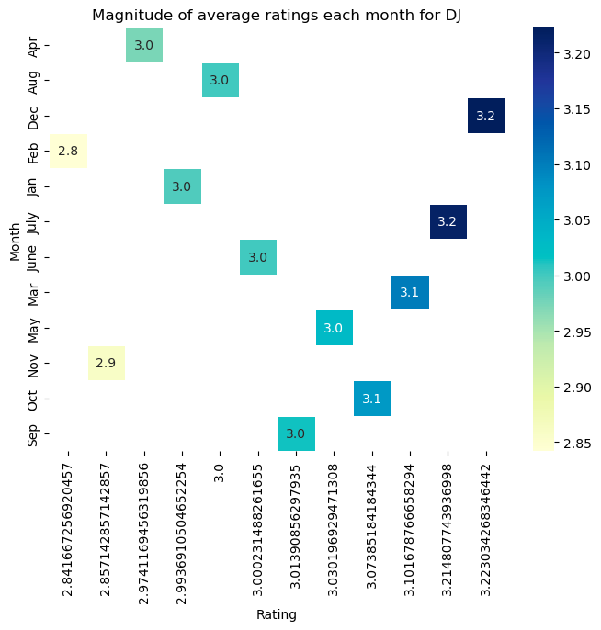
DATA VISUALIZATION 6
Heat Map
Monthly average ratings reached its highest – 3.2 in July and December.
The average ratings saw a dip in February and November with ratings of 2.8 and 2.9, respectively.

Slide 16
Does the rating of Company SNP influence the price of its index?

Slide 17
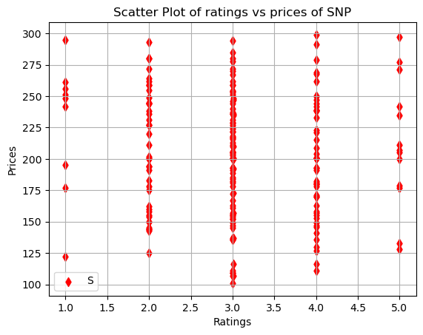
DATA VISUALIZATION 7
Scatter Plot
Illustrates the overall correlation between Company SNP's rating and price.
On average, most SNP indices are assigned a rating of 3.0.
There is no apparent direct relationship between these two variables.

Slide 18
CONCLUSION
The number of Non-Large Company indices exceeds that of Large Company indices.
The indices are distributed equally among three different companies.
The range of indices' prices from these companies doesn't show significant differences.
Company DJ and NASDAQ demonstrate contrasting fluctuation rate trends.
The frequency peaked at over 600 during a fluctuation rate between 8 and 9.
Month played a factor in the ratings for company DJ with highest rating of 3.2 observed in July and December but the rating fell below 3 in February and November 2022.
Most SNP indices have a rating of 3.0, and there is no evident correlation between price and rating.

Slide 19
THANK YOU

